Slide 1
Implementation of ECLI in Latvia
Dace Ezeriete
Project Manager of Project Management and International Cooperation Division
Dace.Ezeriete@ta.gov.lv
8.-9.06.2017, Athens,
BO-ECLI conference «ECLI and beyond – improving online access to court decisions»

Slide 2
Court Administration Republic of Latvia
State institution subordinate to the Minister of Justice
Responsible for administrating of district (city) courts, regional courts and district (city) court Land Registry Offices
Involved in handling human resource matters in the courts and Land Registry Offices, preparing the budgets for courts and Land Registry Offices, providing material technical support, information and communication technology infrastructure, securing the maintenance and development of the information systems (the State Unified Computerized Land Register, the Court Information system and Registry of Enforcement Cases)
National ECLI Coordinator
8.-9.06.2017, Athens
Notes:
Short notice about our institution

Slide 3
Project key facts
Agreement between the European Commission and Court Administration has been concluded on 16 December 2015
Project implementation period 01.03.2016 - 30.09.2017
8.-9.06.2017, Athens
Notes:
Implementation of ECLI in Latvia is still in the process - the project will end only in September this year.
Project is divided into 4 Workstreams (Workstream 0 – Management and Coordination; Workstream 1 – Analysis of existing situation and development of software; Workstream 2 – Assessment of foreign experience; Workstream 3 – ECLI development).

Slide 4
Will ECLI be implemented for all courts?
ECLI will be implemented for all decisions of Supreme Court Republic of Latvia as well as regional and district (city) courts
Constitutional Court of the Republic of Latvia ECLI is introducing separately
8.-9.06.2017, Athens

Slide 5
Will ECLI be assigned to all decisions?
ECLI will not be assigned to previously ruled decisions
It will be applied to all types of decisions which are added and registered in the Court information system, except for cases where either the decisions are resolutions or the decisions are made by an investigative judge
During registering of a decision, ECLI will be assigned automatically. The mandatory and supplemental metadata can then be added
8.-9.06.2017, Athens

Slide 6
Will it be connected to ECLI search engine?
Yes, integration between the Court information system and the ECLI search engine is planned within the project
8.-9.06.2017, Athens

Slide 7
Court Informative System in Latvia
It is a national informative system, which includes recordkeeping and a solution of legal information recording for operational needs and a solution of data distribution for district (city) courts, regional courts and the Supreme Court
Development and the goal of the system is to automate cycle of courts recordkeeping by providing a single electronic information recording, storage, using, transmission and availability, as well as necessary exchange of information between courts and authorities in an automated mode as well as automated statistical preparation of reports
System is used by judges and court staff
8.-9.06.2017, Athens

Slide 8
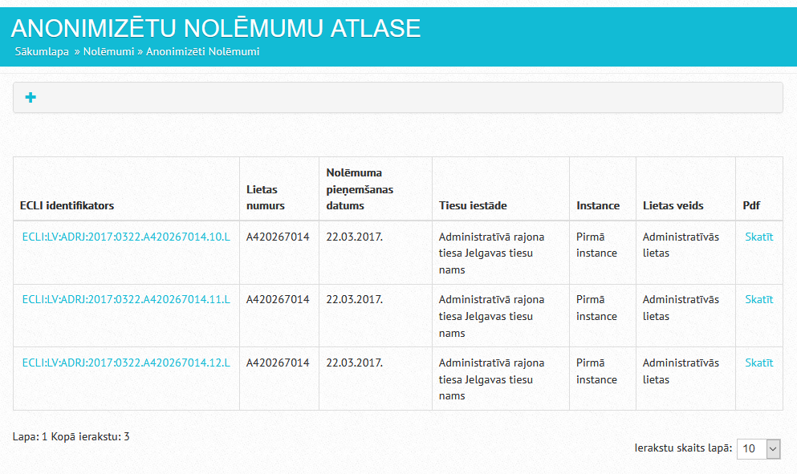
How does ECLI will look like in the system?
8.-9.06.2017, Athens

Slide 9
How will the ECLI look like in Latvia?
8.-9.06.2017, Athens

Slide 10
Did we encounter specific challenges?
Agreement with all involved parties on order number creation principles - on the one hand are calls for complexity, on the other hand are requests for simplicity
Changes were needed in adapting the court name abbreviation classificatory to the ECLI format requirements. The existing classificatory consisted only of numbers, while the ECLI format requires at least one letter
When creating a decision that references other decisions with ECLI, the existence of the decisions are validated against the decisions available in the ECLI search engine. If the validation is successful, a hyperlink is added to the ECLI code leading to the specific decision.
Hopefully integrating of the Court information system with and ECLI search engine will not cause significant issues
In the framework of the project experience of other countries was viewed, for instance, our delegation visited MoJ of Italia and this experience was very useful
8.-9.06.2017, Athens
Notes:
Project has 3 Associated Partners: The National Courts Administration (Lithuania), Ministry of Justice (Italy), Documentary Centre for the Judiciary (Spain).

Slide 11
What is the response from judges?
The Project experts team had several meetings and negations with judges, who voiced their opinions and gave suggestions on how to improve the ECLI order number structure, so that decisions could be easily found by ECLI
A conference will be organized in September this year, during which judges from all regional and district (city) courts will be introduced to the objectives of ECLI and the project goals for ECLI implementation in Latvia. The conference will also include a Q&A session.
8.-9.06.2017, Athens

Slide 12
Thank you for attention!
Dace Ezeriete
Project Manager of Project Management and International Cooperation Division
Dace.Ezeriete@ta.gov.lv
8.-9.06.2017
Athens

